Slide 1
Activity Life Cycle

Slide 2
Cont..
Activities are a fundamental building block of Android applications and they can exist in a number of different states. The activity lifecycle begins with instantiation and ends with destruction, and includes many states in between. When an activity changes state, the appropriate lifecycle event method is called, notifying the activity of the impending state change and allowing it to execute code to adapt to that change.

Slide 3
the activity lifecycle in detail, including:
Activity States
Lifecycle Methods
Retaining the State of an Application

Slide 4
Activity Lifecycle
The Android activity lifecycle comprises a collection of methods exposed within the Activity class that provide the developer with a resource management framework. This framework allows developers to meet the unique state management requirements of each activity within an application and properly handle resource management.

Slide 5
Activity States
The Android OS arbitrates Activities based on their state. This helps Android identify activities that are no longer in use, allowing the OS to reclaim memory and resources. The following diagram illustrates the states an Activity can go through during its lifetime:

Slide 7
These states can be broken into 4 main groups as follows
Active or Running – Activities are considered active or running if they are in the foreground, also known as the top of the activity stack. This is considered the highest priority activity in Android, and as such will only be killed by the OS in extreme situations, such as if the activity tries to use more memory than is available on the device as this could cause the UI to become unresponsive.

Slide 8
Paused
Paused – When the device goes to sleep, or an activity is still visible but partially hidden by a new, non-full-sized or transparent activity, the activity is considered paused. Paused activities are still alive, that is, they maintain all state and member information, and remain attached to the window manager. This is considered to be the second highest priority activity in Android and, as such, will only be killed by the OS if killing this activity will satisfy the resource requirements needed to keep the Active/Running Activity stable and responsive.

Slide 9
Stopped/Backgrounded
Activities that are completely obscured by another activity are considered stopped or in the background. Stopped activities still try to retain their state and member information for as long as possible, but stopped activities are considered to be the lowest priority of the three states and, as such, the OS will kill activities in this state first to satisfy the resource requirements of higher priority activities.

Slide 10
Restarted
It is possible for an activity that is anywhere from paused to stopped in the lifecycle to be removed from memory by Android. If the user navigates back to the activity it must be restarted, restored to its previously saved state, and then displayed to the user.

Slide 11
Activity Re-Creation in Response to Configuration Changes
To make matters more complicated, Android throws one more wrench in the mix called Configuration Changes. Configuration changes are rapid activity destruction/re-creation cycles that occur when the configuration of an activity changes, such as when the device is rotated (and the activity needs to get re-built in landscape or portrait mode), when the keyboard is displayed (and the activity is presented with an opportunity to resize itself), or when the device is placed in a dock, among others

Slide 12
Activity Lifecycle Methods
Android framework provide a powerful model for managing the state of activities within an application. When an activity's state is changing, the activity is notified by the OS, which calls specific methods on that activity. The following diagram illustrates these methods in relationship to the Activity Lifecycle:
The onCreate() and onDestroy() methods are called only once throughout the activity lifecycle.

Slide 14
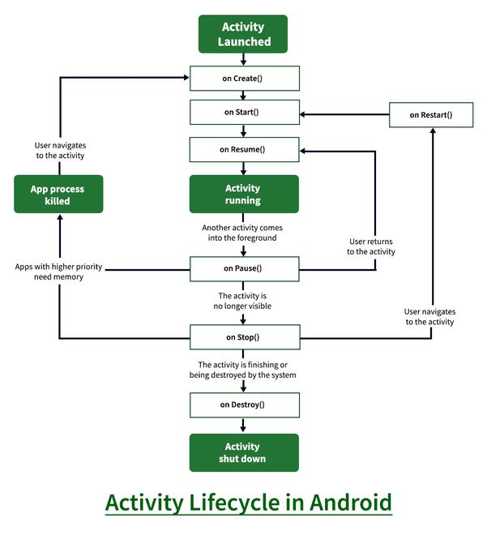

Slide 15
Methods
OnCreate: This is called when activity is first created.
OnStart: This is called when the activity becomes visible to the user.
OnResume: This is called when the activity starts to interact with the user.
OnPause: This is called when activity is not visible to the user.
OnStop: This is called when activity is no longer visible.
OnRestart: This is called when activity is stopped, and restarted again.
OnDestroy: This is called when activity is to be closed or destroyed.

Slide 16
Cont..
As a developer, you can handle state changes by overriding these methods within an activity. It's important to note, however, that all lifecycle methods are called on the UI thread and will block the OS from performing the next piece of UI work, such as hiding the current activity, displaying a new activity, etc. As such, code in these methods should be as brief as possible to make an application feel well performing. Any long-running tasks should be executed on a background thread.

Slide 17
OnCreate
OnCreate is the first method to be called when an activity is created. OnCreate is always overridden to perform any startup initializations that may be required by an Activity such as:
Creating views
Initializing variables
Binding static data to lists

Slide 18
Cont..
OnCreate takes a Bundle parameter, which is a dictionary for storing and passing state information and objects between activities If the bundle is not null, this indicates the activity is restarting and it should restore its state from the previous instance. The following code illustrates how to retrieve values from the bundle:

Slide 19
onStart() Method
When activity start getting visible to user then onStart() will be called.
This calls just after the onCreate() at first time launch of activity.
When activity launch, first onCreate() method call then onStart() and then onResume().
If the activity is in onPause() condition i.e. not visible to user. And if user again launch the activity then onStart() method will be called.

Slide 20
onStart() Example
<RelativeLayout xmlns:android="http://schemas.android.com/apk/res/android" xmlns:app="http://schemas.android.com/apk/res-auto" xmlns:tools="http://schemas.android.com/tools" android:layout_width="fill_parent" android:layout_height="fill_parent">
<TextView android:layout_width="wrap_content" android:layout_height="wrap_content" android:textAppearance="?android:attr/textAppearanceMedium" android:text="onStart() Call after onCreate()" />
</RelativeLayout>

Slide 21
Cont..
Toast.makeText(getApplicationContext(), "First onCreate() calls", Toast.LENGTH_SHORT).show(); //onCreate called
@Override protected void onStart() { super.onStart(); Toast.makeText(getApplicationContext(),"Now onStart() calls", Toast.LENGTH_LONG).show(); //onStart Called }

Slide 22
onPause()
When Activity is in background then onPause() method will execute
Activity is not visible to user and goes in background when onPause() method is executed

Slide 23
Onresume()
Called when the activity will start interacting with the user. At this point your activity is at the top of the activity stack, with user input going to it. Always followed by onPause().

Slide 24
onStop():
Called when you are no longer visible to the user. You will next receive either onRestart(), onDestroy(), or nothing, depending on later user activity.
Note that this method may never be called, in low memory situations where the system does not have enough memory to keep your activity's process running after its onPause() method is called.

Slide 26
When the Activity first time loads the events are called as below
onCreate()
onStart()
onResume()

Slide 27
When you click on Phone button the Activity goes to the background and the below events are called:
onPause()
onStop()
Exit the phone dialer and the below events will be called:
onRestart()
onStart()
onResume()

Slide 28
When you click the back button OR try to finish() the activity the events are called as below:
onPause()
onStop()
onDestroy()

Slide 29
@Override protected void onStart() { super.onStart(); Log.d("lifecycle","onStart invoked"); } @Override protected void onResume() { super.onResume(); Log.d("lifecycle","onResume invoked"); } @Override protected void onPause() { super.onPause(); Log.d("lifecycle","onPause invoked"); } @Override protected void onStop() { super.onStop(); Log.d("lifecycle","onStop invoked"); } @Override protected void onRestart() { super.onRestart(); Log.d("lifecycle","onRestart invoked"); } @Override protected void onDestroy() { super.onDestroy(); Log.d("lifecycle","onDestroy invoked"); }

Slide 30
/

